Slide 1
Where was the Geography in today’s lesson?
What did your pupils need to know already and when did they last learn / retrieve this knowledge and/or skills?
How did you check on prior knowledge and skills?
How did you plan to make meaningful connections between prior (KS1/2/3/4/5) and new knowledge/skills?
How did you encourage your pupils to think like geographers?
Where was the locational knowledge in today’s lesson?
Where was the place knowledge in today’s lesson?
What physical/human processes were in today’s lesson?
What geographical skills were developed in today’s lesson?
How did you build on pupils’ locational framework to strengthen and build a broad-ranging knowledge of locations?
How did you plan to help pupils understand concepts in different locations and scales?
What links did you enable pupils to make to previous physical/human processes knowledge?
How did you plan for pupils to use and construct maps (incl. GIS) to display their knowledge of spatial organisation, location and patterns?
When and how will they retrieve this next?
Where are the next steps on their Geography Journey in terms of knowledge and skills? (short, medium, long term)

Slide 2
How do pupils make progress in geography?
The Geographical Association has produced a progression framework for geography. https://geography.org.uk/ga-guidance-on-progression/. Three aspects of achievement are identified
Contextual world knowledge of locations places and geographical features
Understanding the conditions, processes and interactions that explain features, distribution patterns and changes over time and space.
Competence in geographical enquiry, and the application of skills in observing, collecting , analysing, evaluating and communicating
The Geographical Association has produced some useful benchmark statements that will give you a feel for pitch, these are included on slides 4, 5 and 6. On slide 3 are some questions that will help you to consider how your lessons help pupils to make progress in relation to the three aspects of achievement above.

Slide 3
How do pupils make progress in geography?
How does your lesson / sequence of lessons contribute towards pupils being able to:
Demonstrate greater fluency with world knowledge by drawing on an increasing range of locations and a widening range of examples?
Extend from the familiar and concrete to the unfamiliar and abstract?
Make greater sense of the world by connecting information and ideas about people, places, processes and environments?
Work with increasingly complex information about the world?
Increase the range of geographic skills, and support the pupils in applying these more accurately as they progress towards increasing their independence in geographical enquiry?
Use and apply techniques ‘ in the field’ through practical opportunities to carry out geographical enquiries and investigations?

Slide 4
How do pupils make progress in geography?

Slide 5
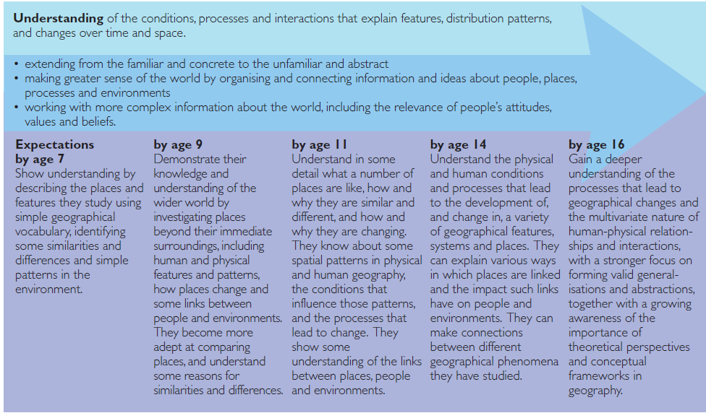
How do pupils make progress in geography?

Slide 6
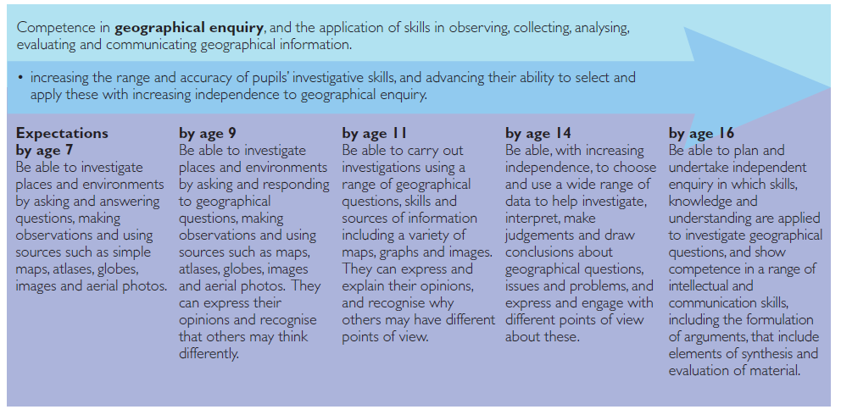
How do pupils make progress in geography?

